Slide 1
Generalised Verification for Quantified Permissions
Final Presentation of Master Thesis Project
Nadja Müller
Supervisor: Alex Summers

Slide 2

Quantified Permissions
Current Structure:
$$forall x:T ∷c\left(x\right)⇒acc\left(e\left(x\right).f, p\left(x\right)\right)$$
c(x): boolean expression
e(x): injective, reference-typed expression
p(x): permission expression
Example:
$$forall x:Ref ∷x in xs⇒acc\left(x.f, write\right)$$

Slide 3
Core Goals
Design & Implementation (Carbon & Silicon):
combinations of quantified pure and permission-based assertions
predicate support within quantified permissions
Design:
magic wand support within quantified permissions
nested quantified permissions

Slide 4
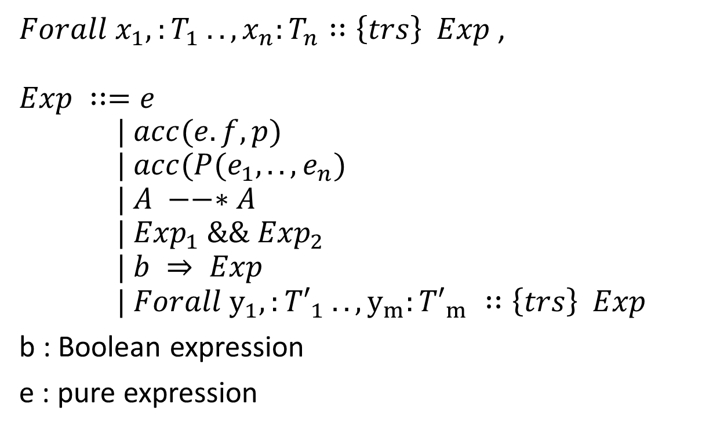
Generalisation
$Forall x_{1},:T_{1} ..,x_{n}:T_{n}∷\left\{trs\right\} Exp$,
$$Exp ∷=e \\ | acc(e.f, p)$$
$$| acc(P(e_{1}, ..,e_{n})$$
$$| A −−∗A$$
$$| {Exp}_{1} \&\&{ Exp}_{2}$$
$$| b ⇒ Exp \\ \text{| }Forall y_{1},:{T′}_{1} ..,y_{m}:{T′}_{m} ∷\left\{trs\right\} Exp$$
b : Boolean expression
e : pure expression
Pure Expression
Field Permission
Predicate Permission
Magic Wand
Conjunction
Implication
Nested Quantifier

Slide 5

Previously allowed Expressions
$Forall x:T∷\left\{trs\right\} Exp$,
$$Exp ∷=e \\ | b⇒acc(e.f, p)$$
$$| acc(P(e_{1}, ..,e_{b})$$
$$| A −−∗A$$
$$| {Exp}_{1} \&\&{ Exp}_{2}$$
$$| b ⇒ Exp$$
| $Forall x_{1},:T_{1} ..,x_{1}:T_{n} ∷\left\{trs\right\} Exp$
b : Boolean expression
e : pure expression
Pure Expression
Field Permission
Predicate Permission
Magic Wand
Conjunction
Implication
Nested Quantifier

Slide 6

Quantified Predicate Permissions
$Forall x:T∷\left\{trs\right\} Exp$,
$$Exp ∷=e \\ | b⇒ acc(e.f, p)$$
$$| b⇒acc(P(e_{1}, ..,e_{n})$$
$$| A −−∗A$$
$$| {Exp}_{1} \&\&{ Exp}_{2}$$
$$| b ⇒ Exp$$
| $Forall x_{1},:T_{1} ..,x_{1}:T_{n} ∷\left\{trs\right\} Exp$
b : Boolean expression
e : pure expression
Pure Expression
Field Permission
Predicate Permission
Magic Wand
Conjunction
Implication
Nested Quantifier

Slide 7
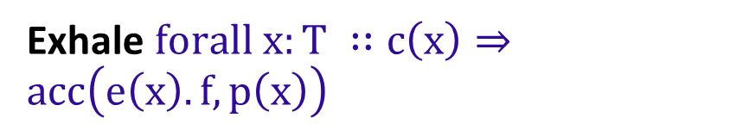

Quantified Field Permissions
Inhale $forall x:T ∷c\left(x\right)⇒acc\left(e\left(x\right).f, p\left(x\right)\right)$
Exhale $forall x:T ∷c\left(x\right)⇒acc\left(e\left(x\right).f, p\left(x\right)\right)$
Define inverse function
Assume receivers are non-null
Define Permissions for general location
Assert injectivity of e(x)
Assert sufficient permission
Define inverse function
Define Permissions for general location

Slide 8
Quantified Field Permissions
Verification Condition Generation
Carbon
Symbolic Exectuion Generation
Silicon
Define translation of quantified inhaling and exhaling
Introduce
Heap representation
inhaling /exhaling Quantified Field Permissions
Adapt
Inhale single field permission
Exhale single field permission
read
write

Slide 9
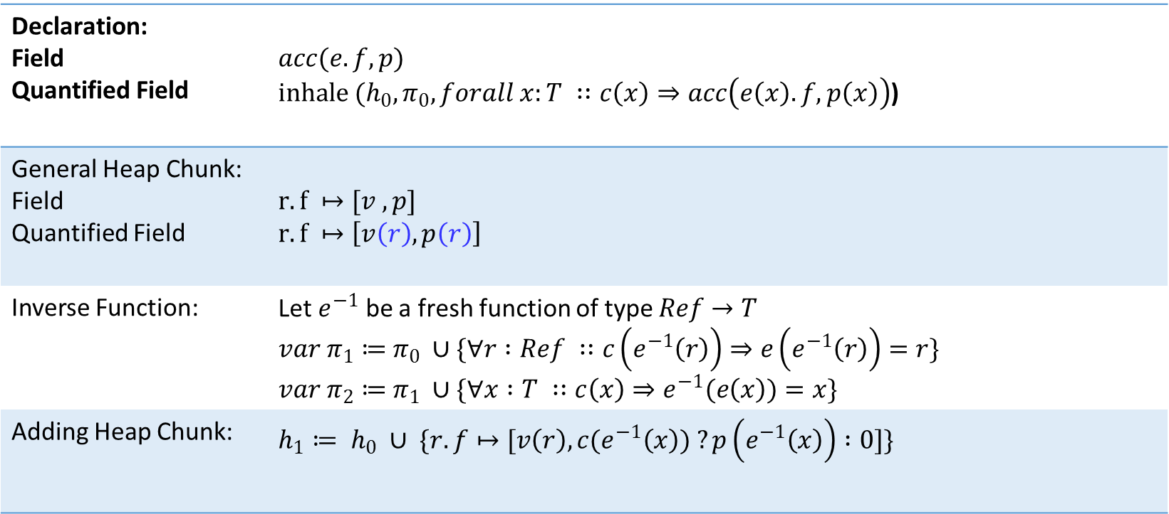
Inhaling Quantified Permissions
Declaration: Field Quantified Field | $$acc(e.f, p)$$ $inhale (h_{0}, π_{0}, forall x:T ∷c\left(x\right)⇒acc\left(e\left(x\right).f, p\left(x\right)\right)$)
General Heap Chunk: Field Quantified Field | $$r.f ↦[v ,p]$$ $$r.f ↦\left[v\left(r\right), p\left(r\right)\right]$$
Inverse Function: | Let $e^{−1}$ be a fresh function of type $Ref→T$ $var π_{1}≔$ $π_{0} ∪\{∀r :Ref ∷c\left(e^{−1}\left(r\right)\right)⇒e\left(e^{−1}\left(r\right)\right)=r\}$ $var π_{2}≔$ $π_{1} ∪\{∀x :T ∷c\left(x\right)⇒e^{−1}(e\left(x\right))=x\}$
Adding Heap Chunk: | $$h_{1}≔ h_{0} ∪ \{r.f↦[v\left(r\right), c(e^{−1}\left(x\right)) ?p\left(e^{−1}\left(x\right)\right) :0]\}$$

Slide 10
Quantified Predicate Permissions
Verification Condition Generation
Carbon
Symbolic Exectuion Generation
Silicon
Define translation of quantified inhaling and exhaling
Introduce
heap representation
Quantified inhaling of predicates
Quantified exhaling of predicates
Adapt
Inhale single predicate permission
Exhale single predicate permission
Fold
Unfold

Slide 11
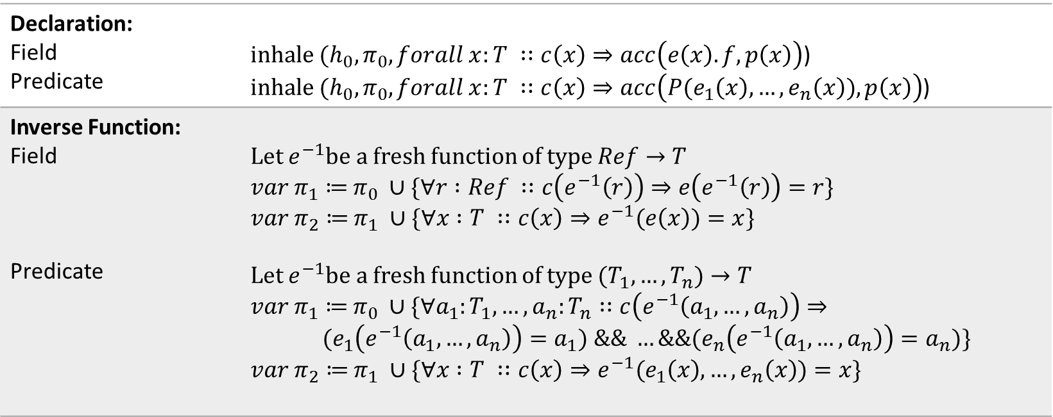
Inhaling Quantified Permissions
Declaration: Field Predicate | $inhale (h_{0}, π_{0}, forall x:T ∷c\left(x\right)⇒acc\left(e\left(x\right).f, p\left(x\right)\right)$) $inhale (h_{0}, π_{0}, forall x:T ∷c\left(x\right)⇒acc\left(P(e_{1}\left(x\right), …,e_{n}\left(x\right)), p\left(x\right)\right)$)
Inverse Function: Field Predicate | Let $e^{−1}$be a fresh function of type $Ref→T$ $var π_{1}≔$ $π_{0} ∪\{∀r :Ref ∷c\left(e^{−1}\left(r\right)\right)⇒e\left(e^{−1}\left(r\right)\right)=r\}$ $var π_{2}≔$ $π_{1} ∪\{∀x :T ∷c\left(x\right)⇒e^{−1}(e\left(x\right))=x\}$ Let $e^{−1}$be a fresh function of type $(T_{1}, …,T_{n})→T$ $var π_{1}≔$ $π_{0} ∪\{∀a_{1}:T_{1}, …,a_{n}:T_{n}∷c\left(e^{−1}\left(a_{1}, …,a_{n}\right)\right)⇒$ $${(e}_{1}\left(e^{−1}\left(a_{1}, …,a_{n}\right)\right)=a_{1}) \&\& …\&\&{(e}_{n}\left(e^{−1}\left(a_{1}, …,a_{n}\right)\right)=a_{n})\}$$ $var π_{2}≔$ $π_{1} ∪\{∀x :T ∷c\left(x\right)⇒e^{−1}(e_{1}\left(x\right), …,e_{n}\left(x\right))=x\}$

Slide 12
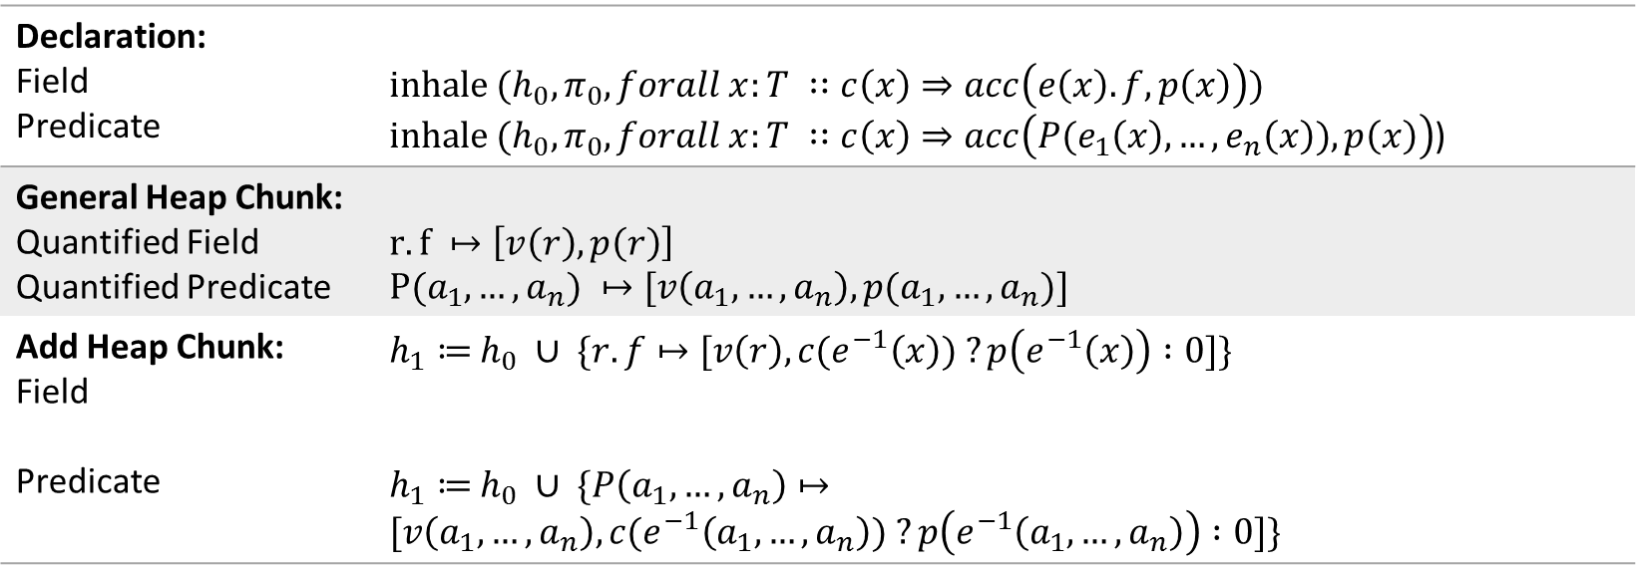
Inhaling Quantified Permissions
Declaration: Field Predicate | $$inhale (h_{0}, π_{0}, forall x:T ∷c\left(x\right)⇒acc\left(e\left(x\right).f, p\left(x\right)\right))$$ $inhale (h_{0}, π_{0}, forall x:T ∷c\left(x\right)⇒acc\left(P(e_{1}\left(x\right), …,e_{n}\left(x\right)), p\left(x\right)\right)$)
General Heap Chunk: Quantified Field Quantified Predicate | $$r.f ↦\left[v\left(r\right), p\left(r\right)\right]$$ $$P(a_{1}, …, a_{n}) ↦[v\left(a_{1}, …, a_{n}\right), p(a_{1}, …, a_{n})]$$
Add Heap Chunk: Field Predicate | $h_{1}≔$ $h_{0} ∪ \{r.f↦[v\left(r\right), c(e^{−1}\left(x\right)) ?p\left(e^{−1}\left(x\right)\right) :0]\}$ $h_{1}≔$ $h_{0} ∪ \{P\left(a_{1}, …,a_{n}\right)↦[v\left(a_{1}, …,a_{n}\right), c(e^{−1}\left(a_{1}, …,a_{n}\right)) ?p\left(e^{−1}\left(a_{1}, …,a_{n}\right)\right) :0]\}$

Slide 13
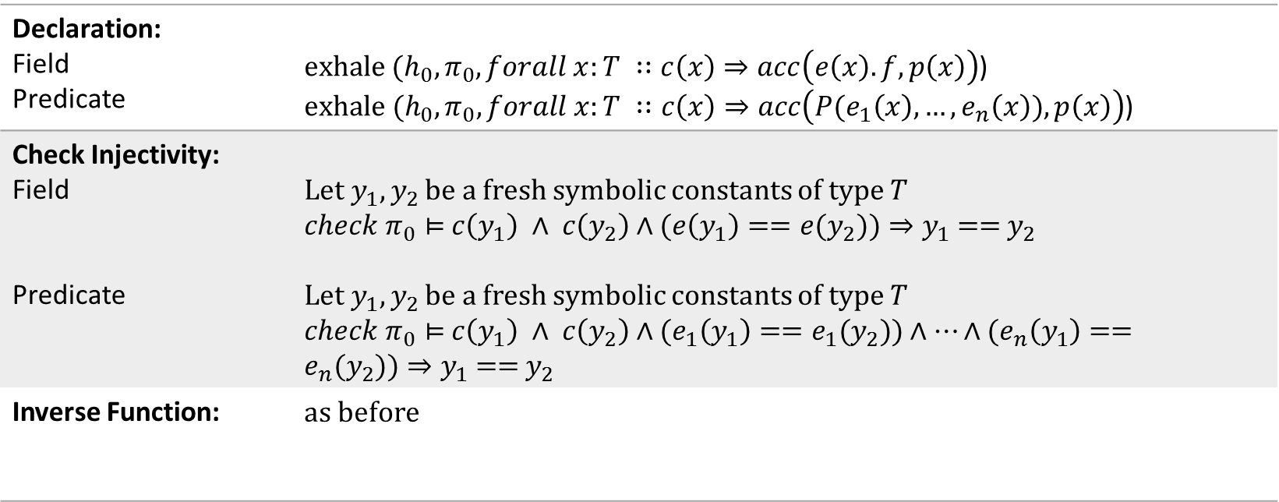
Exhaling Quantified Permissions
Declaration: Field Predicate | $exhale (h_{0}, π_{0}, forall x:T ∷c\left(x\right)⇒acc\left(e\left(x\right).f, p\left(x\right)\right)$) $exhale (h_{0}, π_{0}, forall x:T ∷c\left(x\right)⇒acc\left(P(e_{1}\left(x\right), …,e_{n}\left(x\right)), p\left(x\right)\right)$)
Check Injectivity: Field Predicate | Let$y_{1},y_{2}$ be a fresh symbolic constants of type $T$ $check π_{0}⊨$ $c\left(y_{1}\right) ∧ c\left(y_{2}\right)∧(e\left(y_{1}\right)=={e(y}_{2}))⇒y_{1}\text{ == }y_{2}$ Let$y_{1},y_{2}$ be a fresh symbolic constants of type $T$ $check π_{0}⊨$ $c\left(y_{1}\right) ∧ c\left(y_{2}\right)∧(e_{1}\left(y_{1}\right)=={e_{1}(y}_{2}))∧…∧(e_{n}\left(y_{1}\right)=={e_{n}(y}_{2}))⇒y_{1}\text{ == }y_{2}$
Inverse Function: | as before

Slide 14
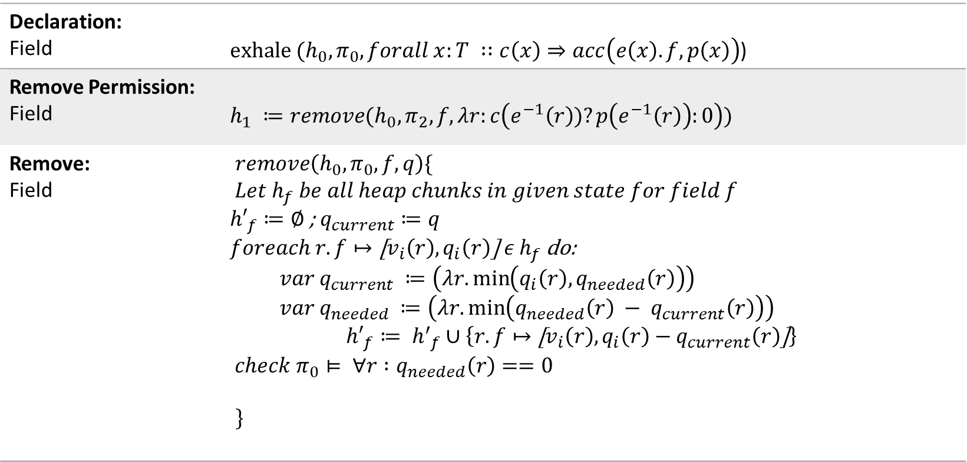
Exhaling Quantified Permissions
Declaration: Field | $exhale (h_{0}, π_{0}, forall x:T ∷c\left(x\right)⇒acc\left(e\left(x\right).f, p\left(x\right)\right)$)
Remove Permission: Field | $$h_{1} ≔remove(h_{0}, π_{2}, f, λr:c\left(e^{−1}\left(r\right))?p\left(e^{−1}\left(r\right)\right):0\right))$$
Remove: Field | $remove\left(h_{0}, π_{0}, f, q\right)\{$ $$Let h_{f} be all heap chunks in given state for field f$$ ${h′}_{f}≔∅$ ; $q_{current}≔q$ $foreach r.f↦\text{[}v_{i}\left(r\right),q_{i}\left(r\right)\text{] }ε h_{f}$ do: $var q_{current} ≔\left(λr.\min\left(q_{i}\left(r\right), q_{needed}\left(r\right)\right)\right)$ $var q_{needed} ≔\left(λr.\min\left(q_{needed}\left(r\right) − q_{current}\left(r\right)\right)\right)$ $${h′}_{f}≔ {h^{′}}_{f}∪\left\{r.f↦\text{[}v_{i}\left(r\right),q_{i}\left(r\right)−q_{current}\left(r\right)\text{]}\right\}$$ $$check{ π}_{0}⊨ ∀r :q_{needed}\left(r\right)==0$$ $\}$

Slide 15
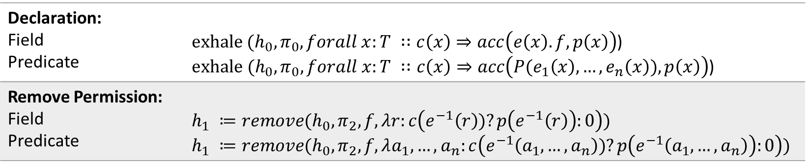
Exhaling Quantified Permissions
Declaration: Field Predicate | $exhale (h_{0}, π_{0}, forall x:T ∷c\left(x\right)⇒acc\left(e\left(x\right).f, p\left(x\right)\right)$) $exhale (h_{0}, π_{0}, forall x:T ∷c\left(x\right)⇒acc\left(P(e_{1}\left(x\right), …,e_{n}\left(x\right)), p\left(x\right)\right)$)
Remove Permission: Field Predicate | $$h_{1} ≔remove(h_{0}, π_{2}, f, λr:c\left(e^{−1}\left(r\right))?p\left(e^{−1}\left(r\right)\right):0\right))$$ $$h_{1} ≔remove(h_{0}, π_{2}, f, λa_{1}, …,a_{n}:c\left(e^{−1}\left(a_{1}, …,a_{n}\right))?p\left(e^{−1}\left(a_{1}, …,a_{n}\right)\right):0\right))$$

Slide 16
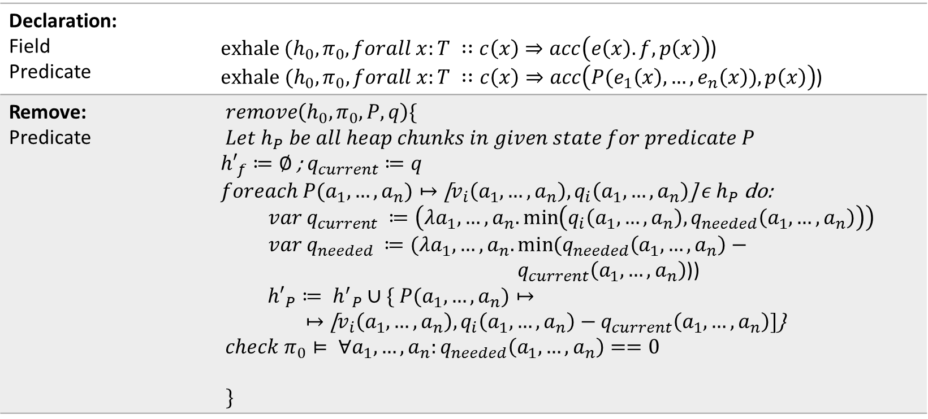
Exhaling Quantified Permissions
Declaration: Field Predicate | $exhale (h_{0}, π_{0}, forall x:T ∷c\left(x\right)⇒acc\left(e\left(x\right).f, p\left(x\right)\right)$) $exhale (h_{0}, π_{0}, forall x:T ∷c\left(x\right)⇒acc\left(P(e_{1}\left(x\right), …,e_{n}\left(x\right)), p\left(x\right)\right)$)
Remove: Predicate | $remove\left(h_{0}, π_{0}, P, q\right)\{$ $$Let h_{P} be all heap chunks in given state for predicate P$$ ${h′}_{f}≔∅$ ; $q_{current}≔q$ $foreach {P(a}_{1}, …,a_{n})↦\text{[}v_{i}\left(a_{1}, …,a_{n}\right),q_{i}\left(a_{1}, …,a_{n}\right)\text{] }ε h_{P}$ do: $var q_{current} ≔\left(λa_{1}, …,a_{n}.\min\left(q_{i}\left(a_{1}, …,a_{n}\right), q_{needed}\left(a_{1}, …,a_{n}\right)\right)\right)$ $var q_{needed} ≔(λa_{1}, …,a_{n}.\min{{(q}_{needed}\left(a_{1}, …,a_{n}\right)−}$ $q_{current}\left(a_{1}, …,a_{n}\right)$)) $${h′}_{P}≔ {h^{′}}_{P}∪\{ P(a_{1}, …,a_{n})↦$$ $↦\text{[}v_{i}\left(a_{1}, …,a_{n}\right),q_{i}\left(a_{1}, …,a_{n}\right)−q_{current}\left(a_{1}, …,a_{n}\right)]$} $$check{ π}_{0}⊨ ∀a_{1}, …,a_{n}:q_{needed}\left(a_{1}, …,a_{n}\right)==0$$ $\}$

Slide 17
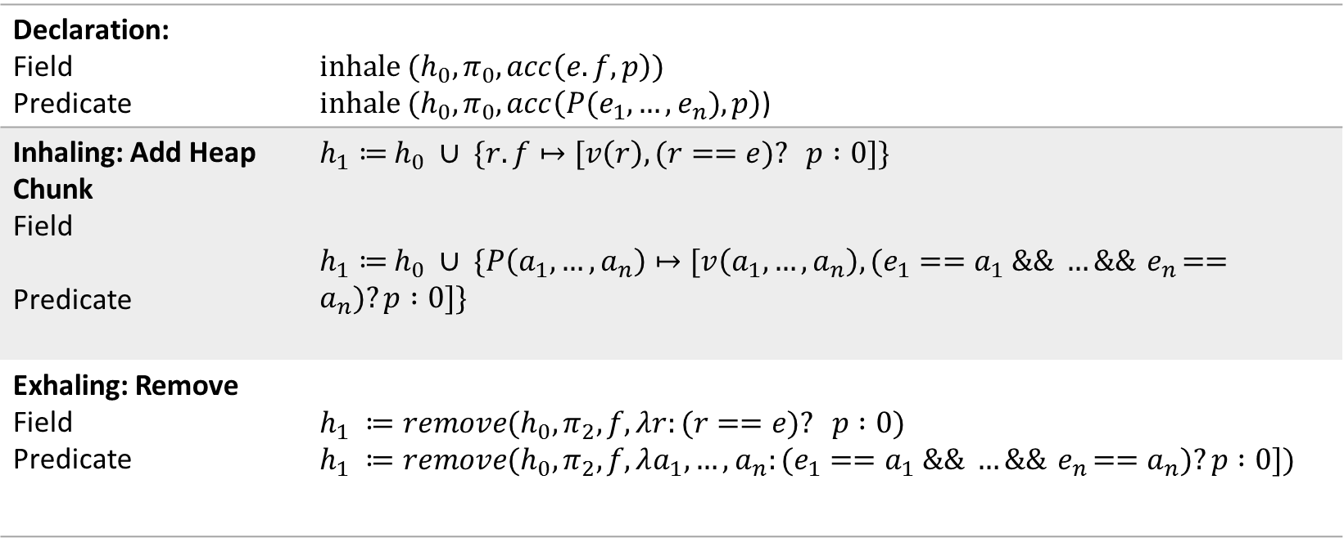
Inhaling/Exhaling Unquantified Permissions
Declaration: Field Predicate | $$inhale (h_{0}, π_{0}, acc\left(e.f, p\right))$$ $inhale (h_{0}, π_{0}, acc\left(P(e_{1}, …,e_{n}), p\right)$)
Inhaling: Add Heap Chunk Field Predicate | $h_{1}≔$ $h_{0} ∪ \{r.f↦[v\left(r\right), (r==e)? p :0]\}$ $h_{1}≔$ $h_{0} ∪ \{P\left(a_{1}, …,a_{n}\right)↦[v\left(a_{1}, …,a_{n}\right), (e_{1}==a_{1} \&\& …\&\&{ e}_{n}==a_{n})?p :0]\}$
Exhaling: Remove Field Predicate | $$h_{1} ≔remove(h_{0}, π_{2}, f, λr:(r==e)? p :0)$$ $$h_{1} ≔remove(h_{0}, π_{2}, f, λa_{1}, …,a_{n}:(e_{1}==a_{1} \&\& …\&\&{ e}_{n}==a_{n})?p :0])$$

Slide 18
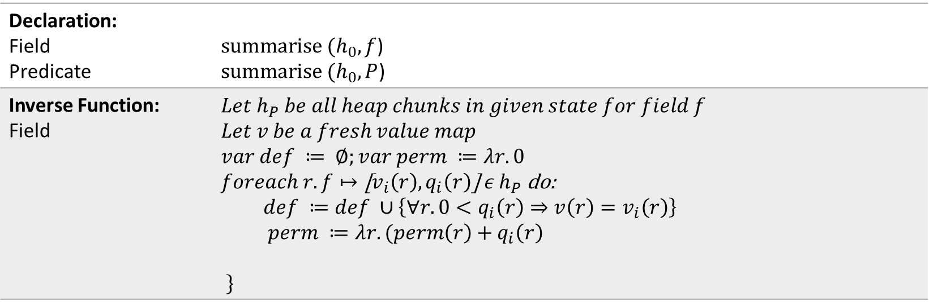
Summarise
Declaration: Field Predicate | $summarise (h_{0}, f$) $summarise (h_{0}, P$)
Inverse Function: Field | $$Let h_{P} be all heap chunks in given state for field f$$ $$Let v be a fresh value map$$ $$var def ≔ ∅;var perm ≔λr.0$$ $foreach r.f↦\text{[}v_{i}\left(r\right),q_{i}\left(r\right)\text{] }ε h_{P}$ do: $$def ≔def ∪\left\{∀r.0<q_{i}\left(r\right)⇒v\left(r\right)=v_{i}\left(r\right)\right\}$$ $$perm ≔λr.(perm\left(r\right)+q_{i}\left(r\right)$$ $\}$

Slide 19
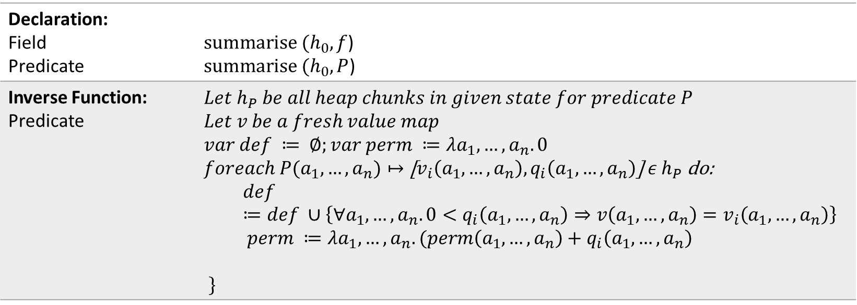
Summarise
Declaration: Field Predicate | $summarise (h_{0}, f$) $summarise (h_{0}, P$)
Inverse Function: Predicate | $$Let h_{P} be all heap chunks in given state for predicate P$$ $$Let v be a fresh value map$$ $$var def ≔ ∅;var perm ≔λa_{1}, …,a_{n}.0$$ $foreach {P(a}_{1}, …,a_{n})↦\text{[}v_{i}\left(a_{1}, …,a_{n}\right),q_{i}\left(a_{1}, …,a_{n}\right)\text{] }ε h_{P}$ do: $$def ≔def ∪\left\{∀a_{1}, …,a_{n}.0<q_{i}\left(a_{1}, …,a_{n}\right)⇒v\left(a_{1}, …,a_{n}\right)=v_{i}\left(a_{1}, …,a_{n}\right)\right\}$$ $$perm ≔λa_{1}, …,a_{n}.(perm\left(a_{1}, …,a_{n}\right)+q_{i}\left(a_{1}, …,a_{n}\right)$$ $\}$

Slide 20
Demo

Slide 21

Permitted Expressions
$Forall x:T∷\left\{trs\right\} Exp$,
$$Exp ∷=e \\ | b⇒acc(e.f, p)$$
$$| b⇒acc(P(e_{1}, ..,e_{b})$$
$$| A −−∗B$$
$$| {Exp}_{1} \&\&{ Exp}_{2}$$
$$| b ⇒ Exp$$
| $Forall x_{1},:T_{1} ..,x_{1}:T_{n} ∷\left\{trs\right\} Exp$
b : Boolean expression
e : pure expression
Pure Expression
Field Permission
Predicate Permission
Magic Wand
Conjunction
Implication
Nested Quantifier

Slide 22
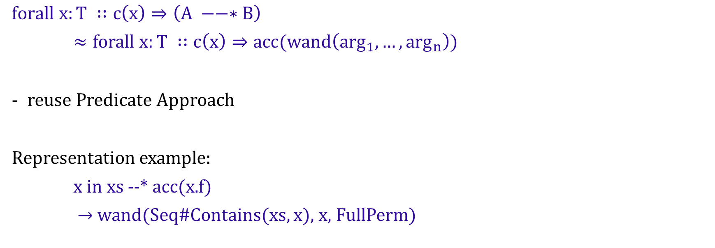
Quantified Magic Wand Permissions
might depend on x
$$forall x:T ∷c\left(x\right)⇒\left(A −−∗B\right)$$
$≈forall x:T ∷c\left(x\right)⇒acc(wand\left(\arg_{1}, …,\arg_{n}\right))$
reuse Predicate Approach
Representation example:
x in xs --* acc(x.f)
$→$wand(Seq#Contains(xs, x), x, FullPerm)

Slide 23
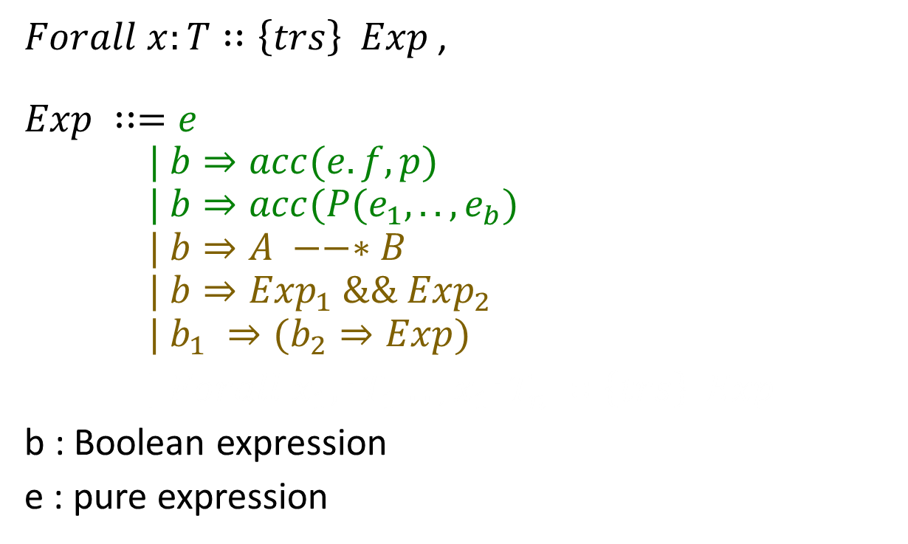
Combinations of Quantifiers
$Forall x:T∷\left\{trs\right\} Exp$,
$$Exp ∷=e \\ | b⇒acc(e.f, p)$$
$$| b⇒acc(P(e_{1}, ..,e_{b})$$
$$| b⇒A −−∗B$$
$$| {b⇒Exp}_{1} \&\&{ Exp}_{2}$$
$$| b_{1} ⇒(b_{2}⇒Exp)$$
| $Forall x_{1},:T_{1} ..,x_{1}:T_{n} ∷\left\{trs\right\} Exp$
b : Boolean expression
e : pure expression
Pure Expression
Field Permission
Predicate Permission
Magic Wand
Conjunction
Implication
Nested Quantifier

Slide 24

Combination: Rewriting Rules
$forall x:T ∷\left\{trs\right\} c\left(x\right)⇒(b\left(x\right)⇒expr)$
$→forall x:T ∷\left\{trs\right\} (c\left(x\right) \&\& b(x))⇒expr$
$forall x:T ∷\left\{trs\right\} c\left(x\right)⇒{expr}_{1} \&\& {expr}_{2}$
$→forall x:T ∷\left\{trs\right\} c\left(x\right)⇒{expr}_{1}$
$→forall x:T ∷\left\{trs\right\} c\left(x\right)⇒{expr}_{2}$

Slide 25

Condition Constraint
$Forall x:T∷\left\{trs\right\} Exp$,
$$Exp ∷=e \\ | acc(e.f, p)$$
$$| acc(P(e_{1}, ..,e_{b})$$
$$| A −−∗B$$
$$| {Exp}_{1} \&\&{ Exp}_{2}$$
$$| b⇒Exp$$
| $Forall x_{1},:T_{1} ..,x_{1}:T_{n} ∷\left\{trs\right\} Exp$
b : Boolean expression
e : pure expression
Pure Expression
Field Permission
Predicate Permission
Magic Wand
Conjunction
Implication
Nested Quantifier

Slide 26

Condition Constraint: Rewriting Rules
$$forall x:T ∷acc\left(e\left(x\right).f, p\left(x\right)\right)$$
$$⟼forall x:T ∷true⇒acc\left(e\left(x\right).f, p\left(x\right)\right)$$

Slide 27
Demo

Slide 28
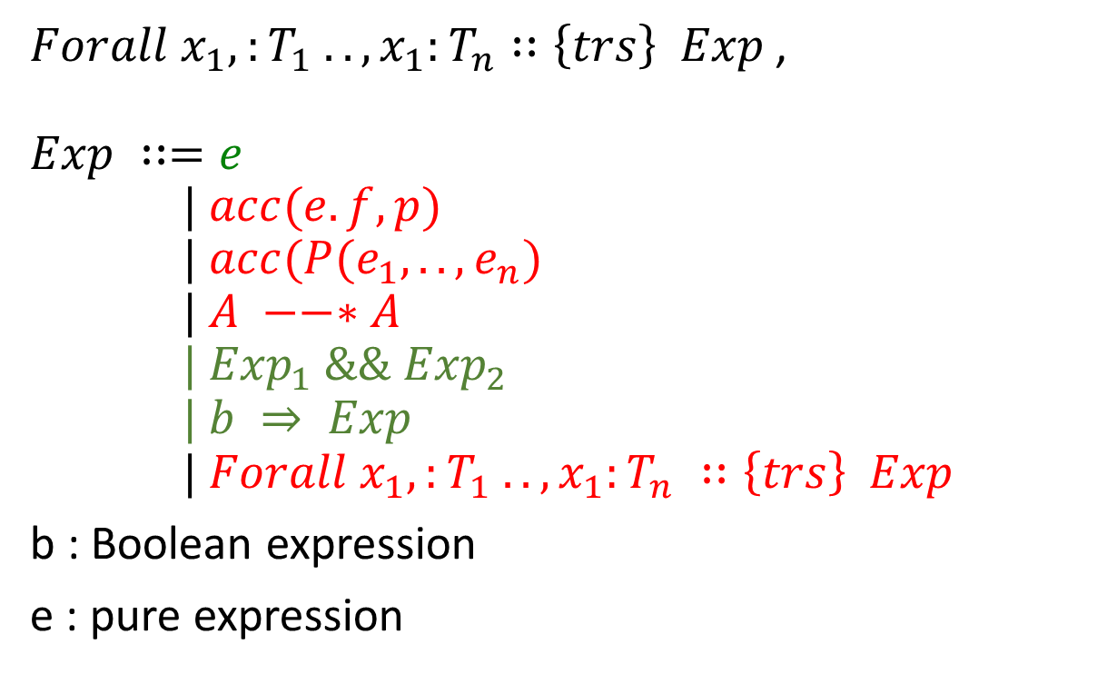
Nested Quantifiers
$Forall x_{1},:T_{1} ..,x_{1}:T_{n}∷\left\{trs\right\} Exp$,
$$Exp ∷=e \\ | acc(e.f, p)$$
$$| acc(P(e_{1}, ..,e_{n})$$
$$| A −−∗A$$
$$| {Exp}_{1} \&\&{ Exp}_{2}$$
$$| b ⇒ Exp \\ \text{| }Forall x_{1},:T_{1} ..,x_{1}:T_{n} ∷\left\{trs\right\} Exp$$
b : Boolean expression
e : pure expression
Pure Expression
Field Permission
Predicate Permission
Magic Wand
Conjunction
Implication
Nested Quantifier

Slide 29
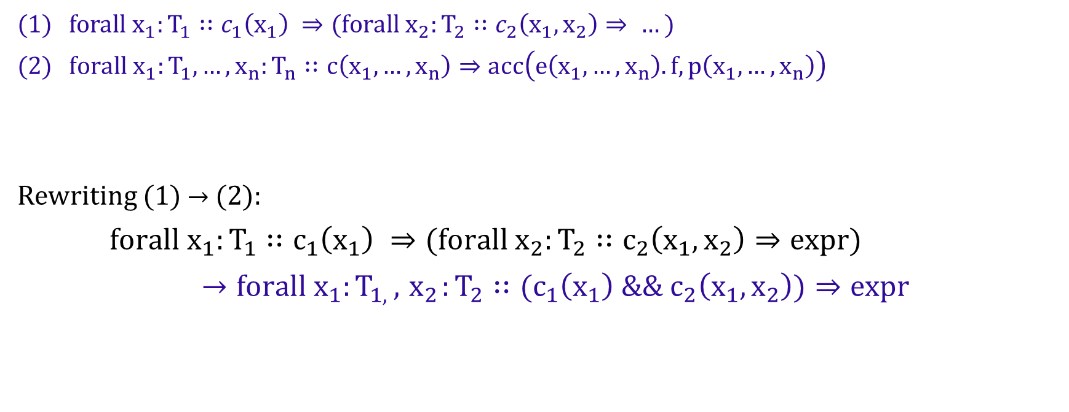
Nested Quantified Permissions
$forall{ x}_{1}:T_{1}∷c_{1}\left(x_{1}\right) ⇒(forall{ x}_{2}:T_{2}∷c_{2}\left(x_{1}, x_{2}\right)⇒ …)$
$forall x_{1}:T_{1},…,x_{n}:T_{n}∷c\left(x_{1}, …,x_{n}\right)⇒acc\left(e\left(x_{1}, …,x_{n}\right).f, p\left(x_{1}, …,x_{n}\right)\right)$
Rewriting (1) $→$ (2):
$forall{ x}_{1}:T_{1}∷c_{1}\left(x_{1}\right) ⇒(forall{ x}_{2}:T_{2}∷c_{2}\left({x_{1}, x}_{2}\right)⇒expr)$
$→forall{ x}_{1}:T_{1, },{ x}_{2}:T_{2}∷(c_{1}\left(x_{1}\right) \&\&{ c}_{2}\left({x_{1}, x}_{2}\right))⇒expr$

Slide 30
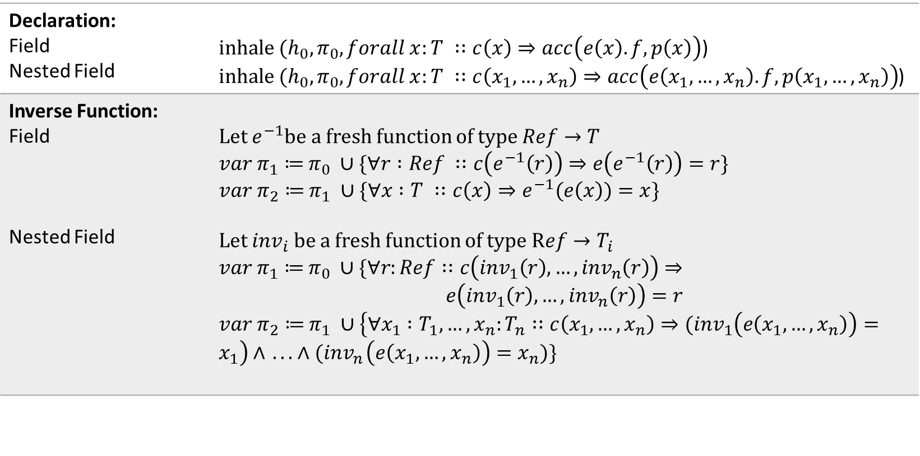
Inhaling Quantified Permissions
Declaration: Field Nested Field | $inhale (h_{0}, π_{0}, forall x:T ∷c\left(x\right)⇒acc\left(e\left(x\right).f, p\left(x\right)\right)$) $inhale (h_{0}, π_{0}, forall x:T ∷c\left(x_{1}, …,x_{n}\right)⇒acc\left(e\left(x_{1}, …,x_{n}\right).f, p\left(x_{1}, …,x_{n}\right)\right)$)
Inverse Function: Field Nested Field | Let $e^{−1}$be a fresh function of type $Ref→T$ $var π_{1}≔$ $π_{0} ∪\{∀r :Ref ∷c\left(e^{−1}\left(r\right)\right)⇒e\left(e^{−1}\left(r\right)\right)=r\}$ $var π_{2}≔$ $π_{1} ∪\{∀x :T ∷c\left(x\right)⇒e^{−1}(e\left(x\right))=x\}$ Let ${inv}_{i}$ be a fresh function of type $Ref→T_{i}$ $var π_{1}≔$ $π_{0} ∪\{∀r:Ref∷c\left({inv}_{1}\left(r\right), …,{inv}_{n}\left(r\right)\right)⇒$ $$e\left({inv}_{1}\left(r\right), …,{inv}_{n}\left(r\right)\right)=r$$ $var π_{2}≔$ $π_{1} ∪\left\{∀x_{1} :T_{1}, …,x_{n}:T_{n}∷c\left(x_{1}, …,x_{n}\right)⇒{(inv}_{1}\left(e\left(x_{1}, …,x_{n}\right)\right)=x_{1}\right)∧{ .. . ∧(inv}_{n}\left(e\left(x_{1}, …,x_{n}\right)\right)=x_{n})\}$

Slide 31
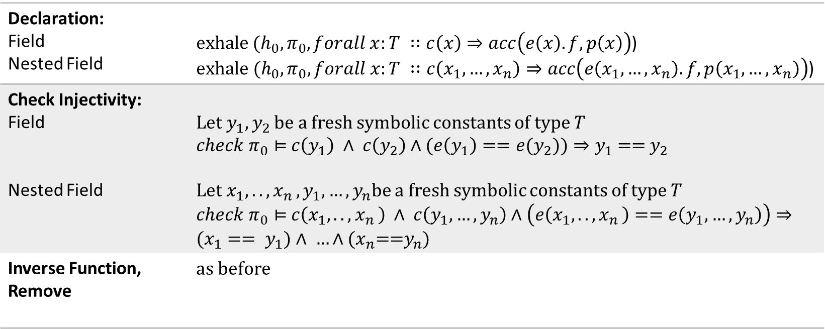
Exhaling Quantified Permissions
Declaration: Field Nested Field | $exhale (h_{0}, π_{0}, forall x:T ∷c\left(x\right)⇒acc\left(e\left(x\right).f, p\left(x\right)\right)$) $exhale (h_{0}, π_{0}, forall x:T ∷c\left(x_{1}, …,x_{n}\right)⇒acc\left(e\left(x_{1}, …,x_{n}\right).f, p\left(x_{1}, …,x_{n}\right)\right)$)
Check Injectivity: Field Nested Field | Let$y_{1},y_{2}$ be a fresh symbolic constants of type $T$ $check π_{0}⊨$ $c\left(y_{1}\right) ∧ c\left(y_{2}\right)∧(e\left(y_{1}\right)=={e(y}_{2}))⇒y_{1}\text{ == }y_{2}$ Let$x_{1},..,x_{n },y_{1}, …,y_{n}$be a fresh symbolic constants of type $T$ $check π_{0}⊨$ $c\left(x_{1},..,x_{n }\right) ∧ c\left(y_{1}, …,y_{n}\right)∧\left(e\left(x_{1},..,x_{n }\right)==e\left(y_{1}, …,y_{n}\right)\right)⇒(x_{1}== y_{1})∧ …∧{(x}_{n}\text{==}y_{n}$)
Inverse Function, Remove | as before

Slide 32
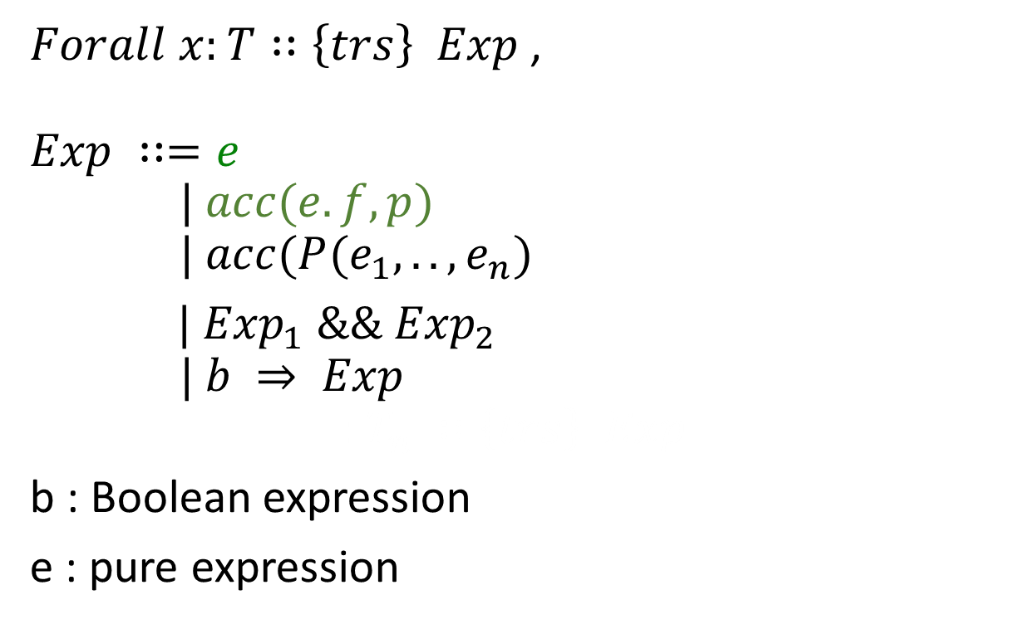
Supported Expressions (Carbon & Silicon)
$Forall x:T∷\left\{trs\right\} Exp$,
$$Exp ∷=e \\ | acc(e.f, p)$$
$$| acc(P(e_{1}, ..,e_{n})$$
$| {Exp}_{1} \&\&{ Exp}_{2}$
$$| b ⇒ Exp$$
$$:T_{n} ∷\left\{trs\right\} Exp$$
b : Boolean expression
e : pure expression
Pure Expression
Field Permission
Predicate Permission
Conjunction
Implication

Slide 33
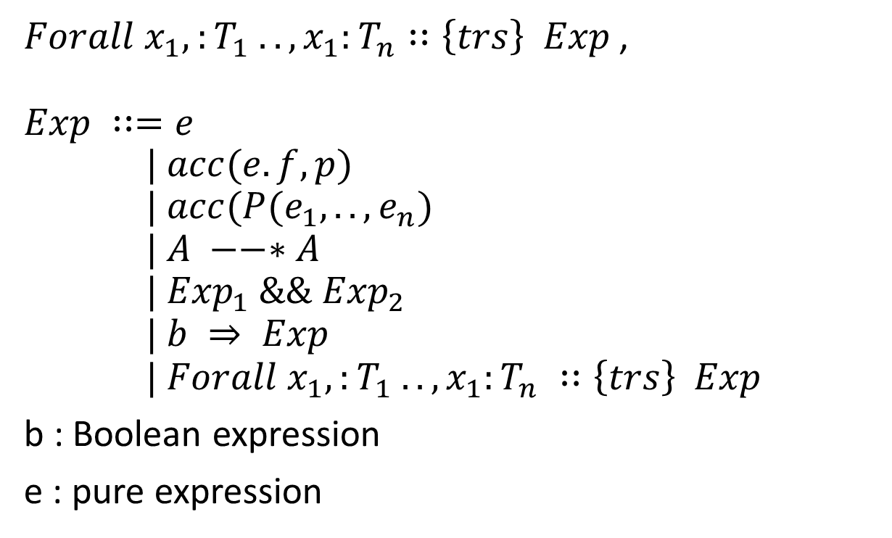
Generalisation
$Forall x_{1},:T_{1} ..,x_{1}:T_{n}∷\left\{trs\right\} Exp$,
$$Exp ∷=e \\ | acc(e.f, p)$$
$$| acc(P(e_{1}, ..,e_{n})$$
$$| A −−∗A$$
$$| {Exp}_{1} \&\&{ Exp}_{2}$$
$$| b ⇒ Exp \\ \text{| }Forall x_{1},:T_{1} ..,x_{1}:T_{n} ∷\left\{trs\right\} Exp$$
b : Boolean expression
e : pure expression
Pure Expression
Field Permission
Predicate Permission
Magic Wand
Conjunction
Implication
Nested Quantifier

